Slide 1
Careers Information
Energy and Utilities Industries
Module 1
2013

Slide 2
Definition
Careers Information is information specifically to help you make good career choices.
It can be presented in a variety of formats; paper, electronic, verbal and needs to attempt to answer a broad range of questions.

Slide 3

What information is usually included?
Job role and tasks
Skills and qualities
Qualifications needed
Training required
Job availability
Pay and conditions
Progression
Further sources
Related jobs

Slide 4

Who provides careers information?
Industry bodies
Sector Skills Councils
Government Departments
Careers advisors
Employers
Individuals

Slide 5
Careers Information
Should
Shouldn’t
promote equality of opportunity
be up to date, no more than two years old
be explained or mediated by an advisor if required
be accurate
take account of different learning styles
reinforce stereotypes
be physically inaccessible – no access to internet or library
be confusingly presented or hard to navigate
be biased or blatant marketing

Slide 6


Careers information: labour market information?
Labour Market Information tells you about the workplace using data, graphs and statistics to describe the condition of the labour market past, present and in the future.
In a more mediated form it is known as Labour Market Intelligence, where data is repackaged and targeted more specifically for the person seeking careers information, advice and guidance.
Essentially, in one form or another, most careers information is labour market information.

Slide 7

Presenting careers information
Clarity is vital
Visuals such as videos or photographs are helpful
Personal reflections add another dimension
Useful to link to live job vacancies
Accessibility is very important (languages, colours, font, gender etc.)

Slide 8
How effective is careers information?
Evidence from a survey in What is Effective Guidance? Evidence from Longitudinal Case Studies in England (Bimrose, Barnes, Hughes and Orton, 2004) indicated that useful guidance includes:
“providing a client with access to information, leading to a feeling of being better informed”
and
“ developing a client’s understanding, increasing their awareness, broadening their ideas…….. motivating, inspiring and encouraging clients”
Clearly careers information has a vital role to play in delivering good quality careers advice and guidance

Slide 9
Current government policy
Governments currently promote the use of websites as the primary source of careers information, along with a ‘self-help’ philosophy.
The “Helping Individuals to Succeed: Transforming Career Guidance” report suggests that new technology can be harnessed better in careers guidance by:
“creating a ‘careers library’ online and providing information about jobs and courses linked to information from other sites, for example, from employers’ websites, including the use of pictures and videos. “
And goes on to point out that
“Individuals with digital literacy, information handling and career management skills make best use of online provision.”
Helping Individuals to Succeed: Transforming Career Guidance UKCES August 2011

Slide 10
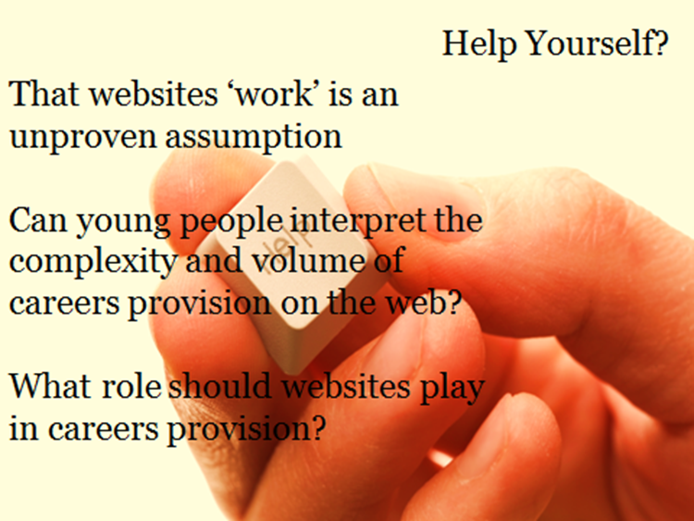
Help Yourself: Can Career Websites make a difference? (Semple, Howieson 2011)
Recent research suggests that not all young people are confident web information managers and need to support to find the careers information they need on the web.
“You get so much information, you don’t know which bits are right for you, would apply to you. It needs someone to make sense of it for you. What do you do?”
(S4/year 11 pupil)

